Slide 1


Slide 2
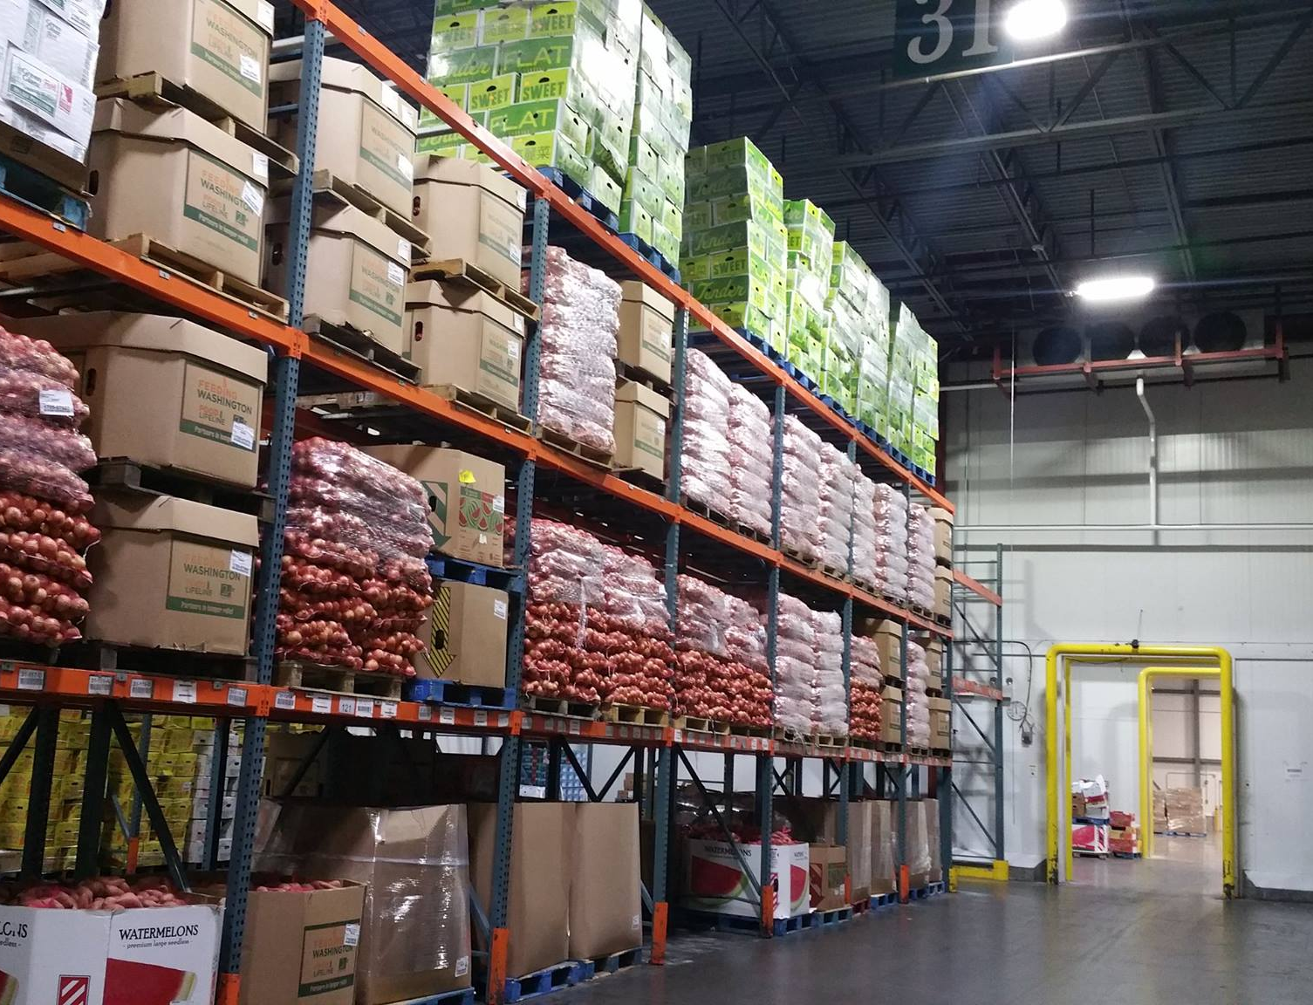
About
Harvesters
Harvesters is a food bank.
A food bank acquires, stores
and distributes food to a network
of partner agencies including
pantries, shelters and community
kitchens.

Slide 3
Harvesters’ Mission
Harvesters mobilizes the power of our community to provide equitable access to nutritious food and address the root causes and impact of hunger.

Slide 4
Harvesters’ Vision
Our vision is a healthy, thriving community
where no one is hungry.

Slide 5
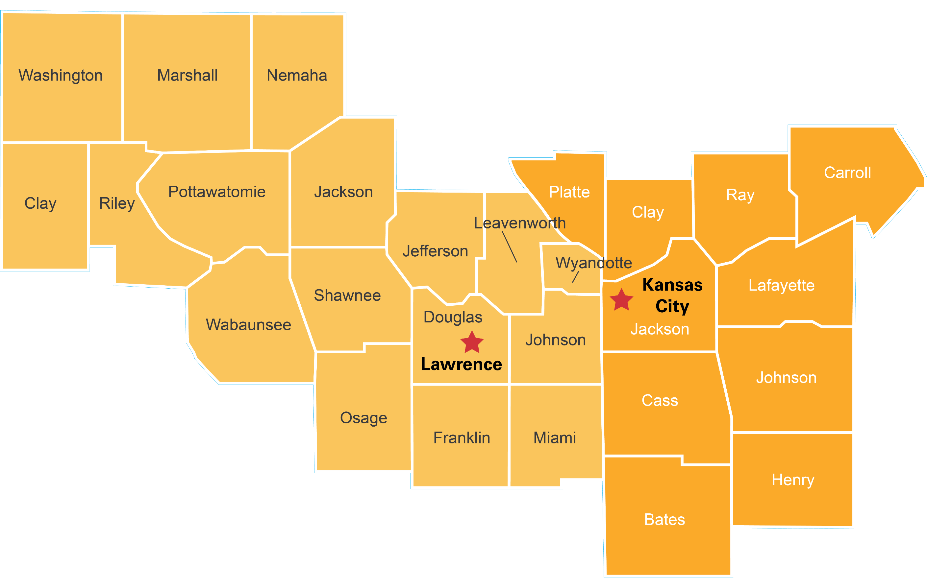
Our Service Area
Proudly serving
27 counties
in Kansas
and Missouri.
www.harvesters.org

Slide 6
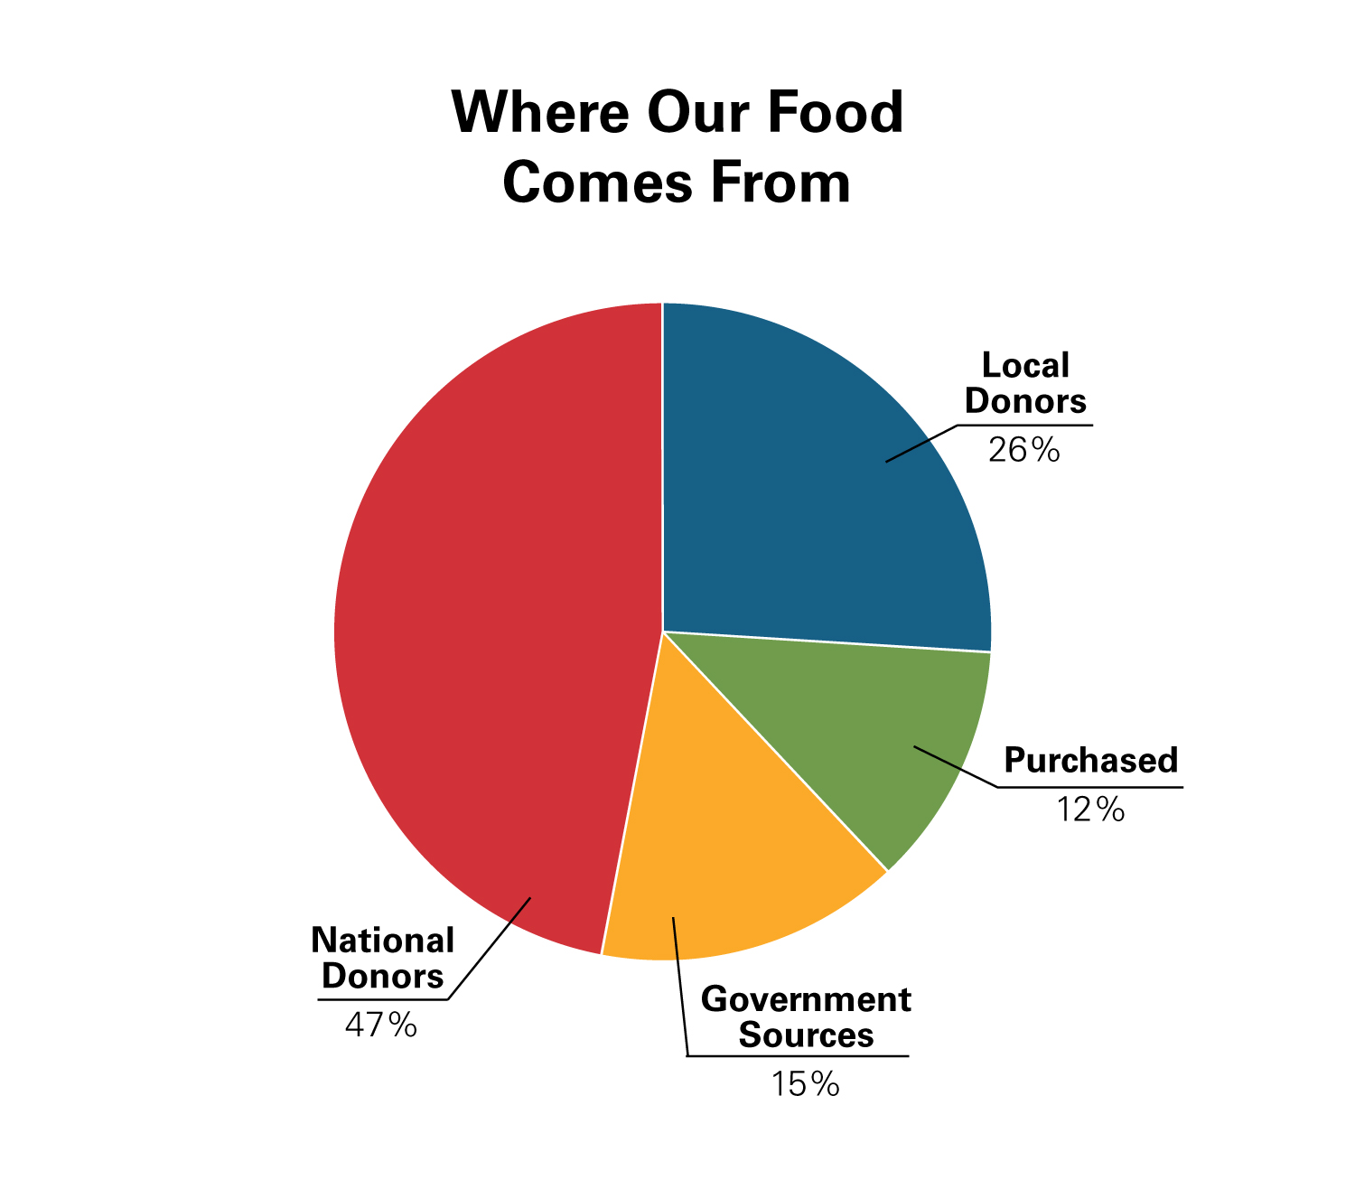
Where Our Food Comes From
In FY25, we acquired 60 million pounds of food from:
Local Sources
Feeding America
Gov’t. Sources
Purchased by Harvesters
www.harvesters.org

Slide 7
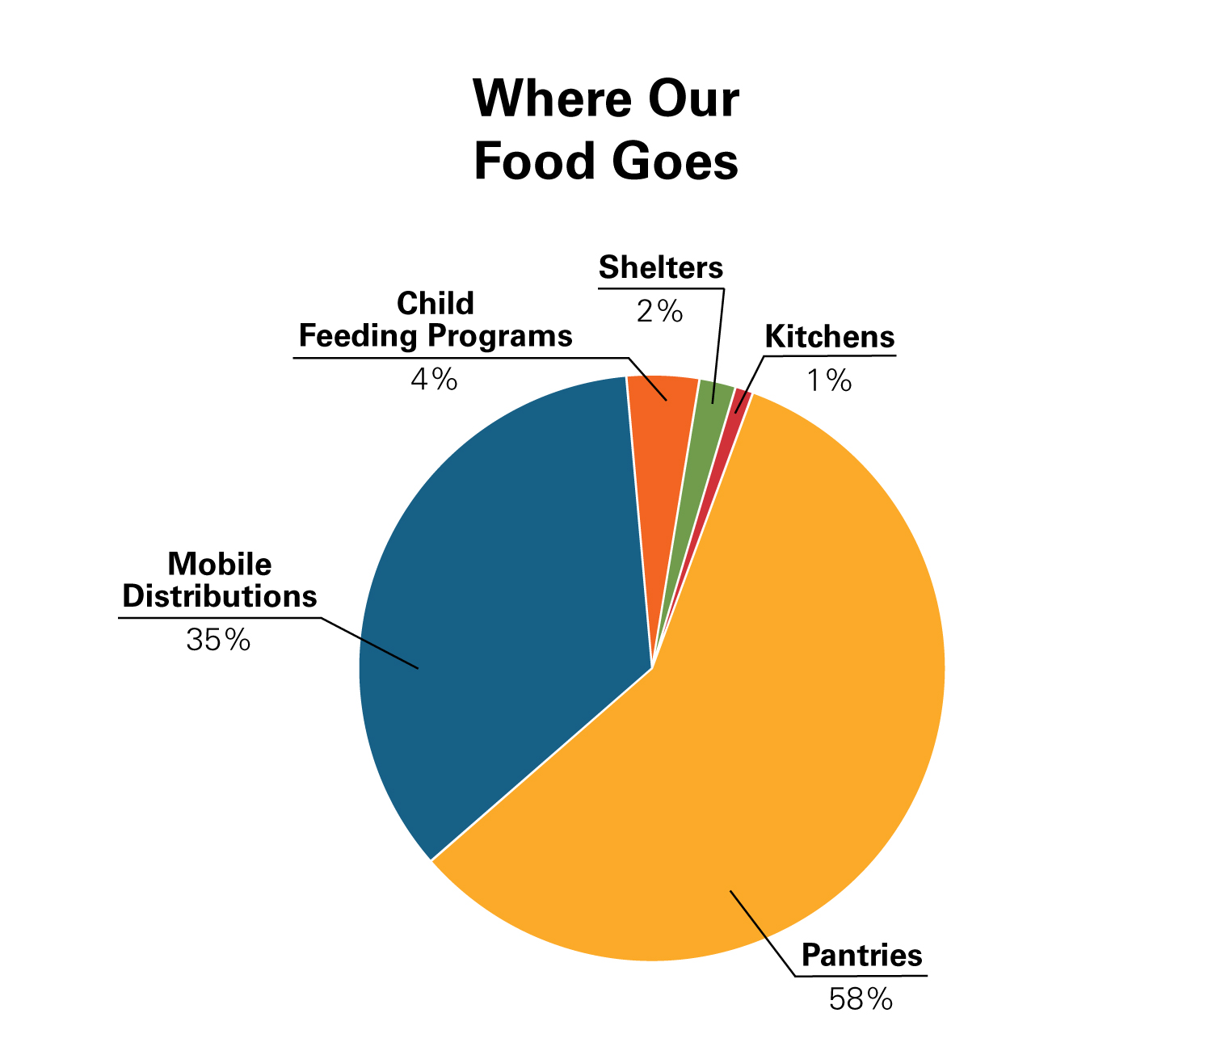
Where Our Food Goes
Harvesters distributes the acquired food to:
Pantries
Kitchens
Shelters
Child Meal Programs
Mobile Distributions
www.harvesters.org

Slide 8
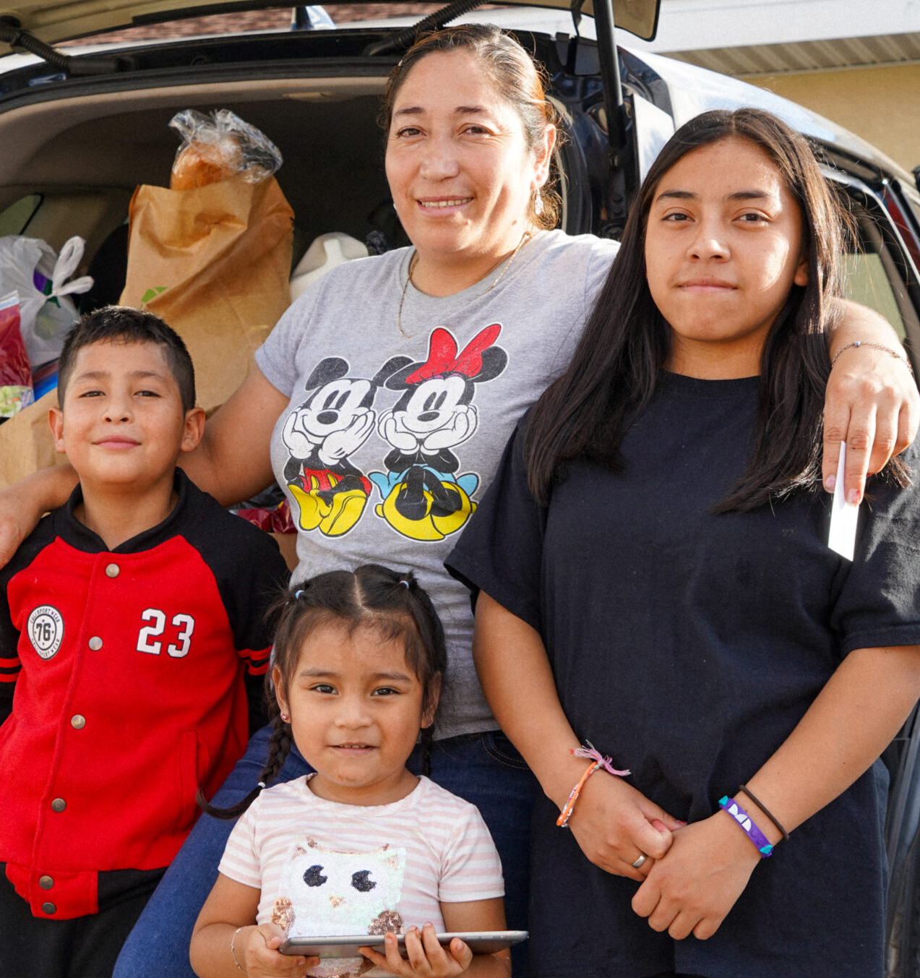
The Stark Reality:
1 in 7 people in our service area currently experiences food insecurity.
1 in 6 children is at risk of hunger.
70 percent of households served have incomes
of $25,000 or less.
108 billion pounds of food are wasted each year.

Slide 9
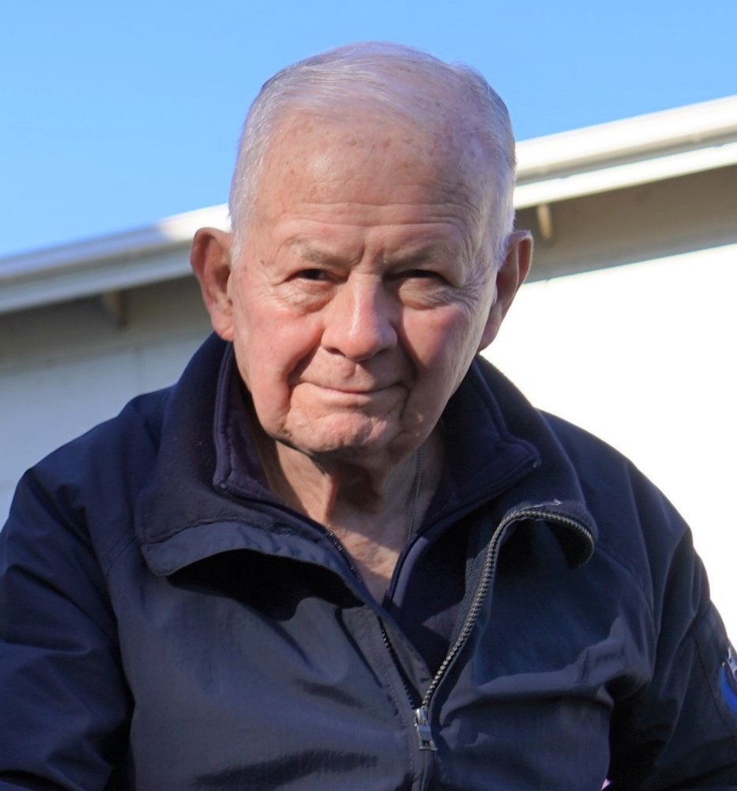
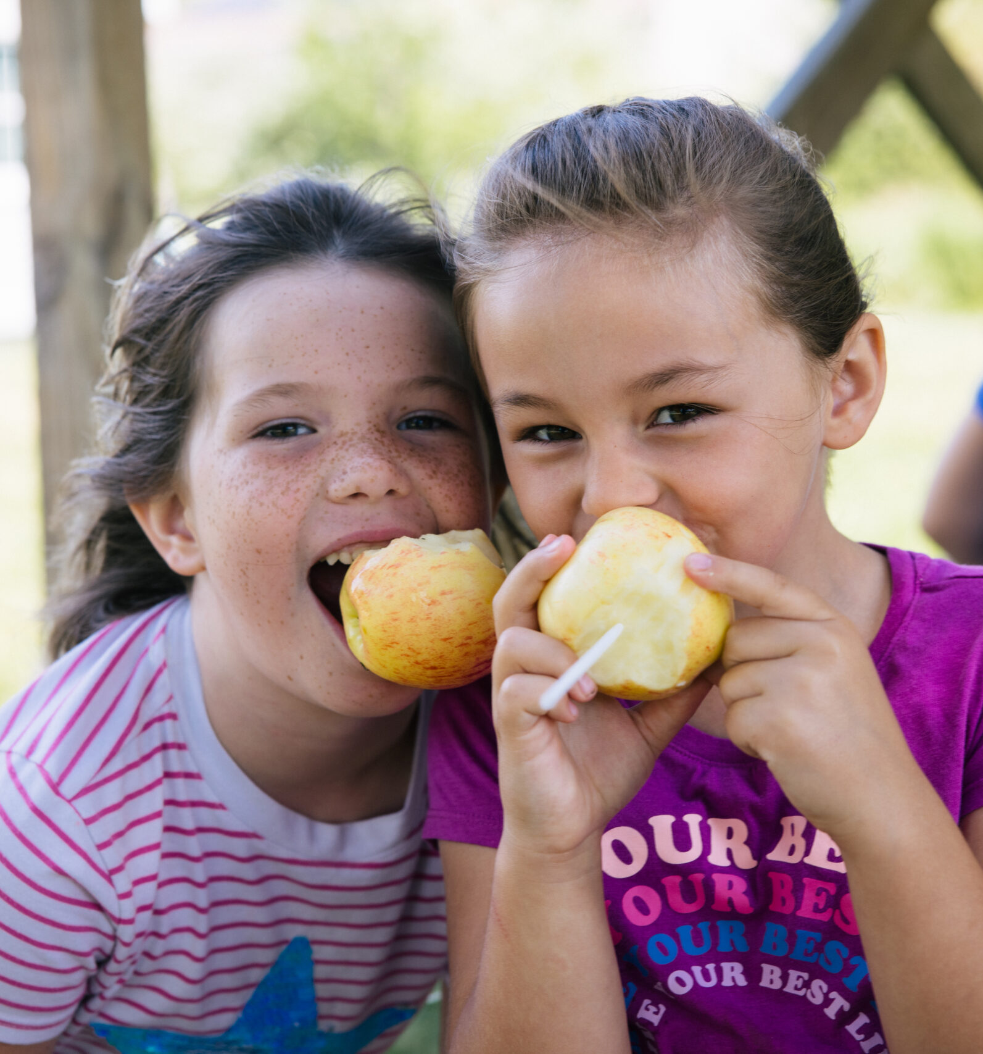
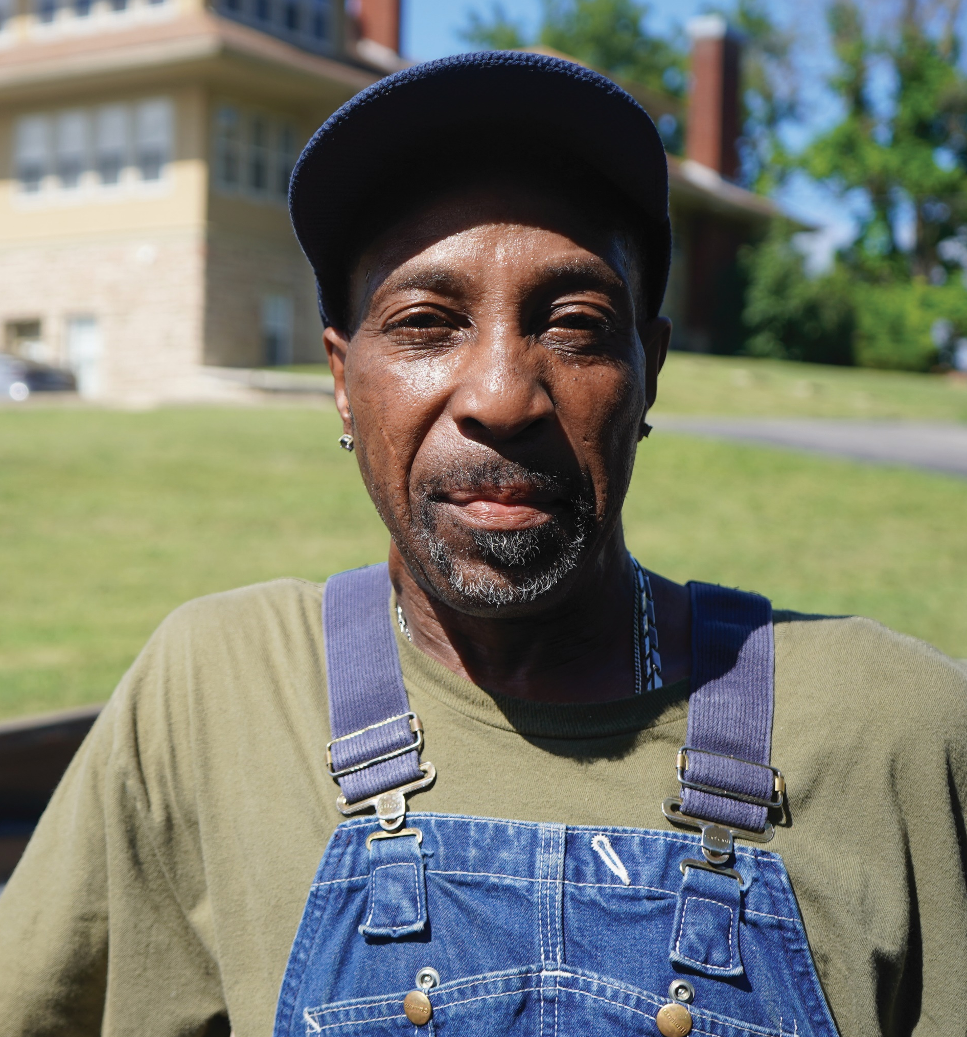
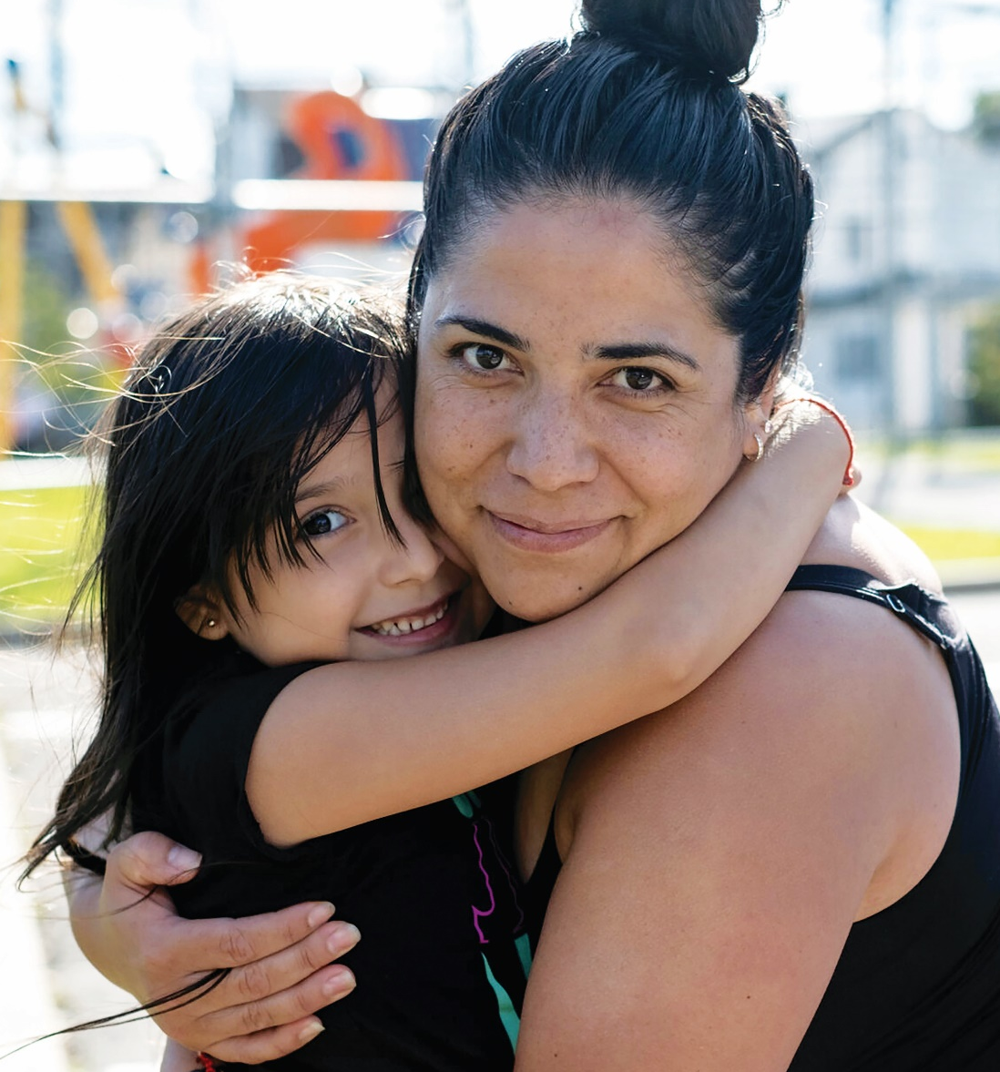
Who We Serve
15% are Seniors
35% are Children
61% have at least one adult who has worked in the last year
9% are living in temporary housing or are houseless

Slide 10
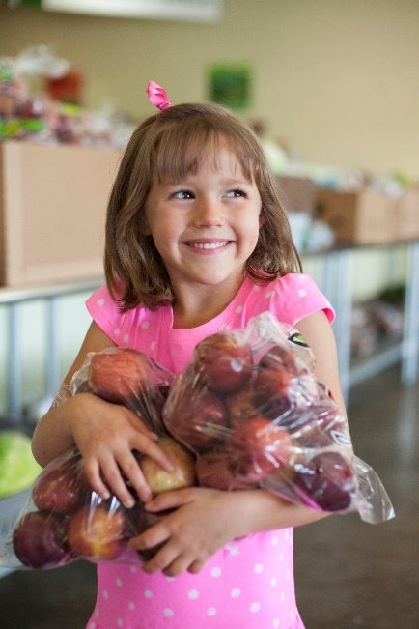
Feeding Children
BackSnacks:
  4 meals and 2 snacks each weekend.
  Cost: $250/child.
  Schools determine which students need BackSnacks.
School Pantry:
  The School Pantry program is a food pantry conveniently located on-site at schools for families of students in need.
  Last fiscal year, there were more than 60 school pantries.

Slide 11
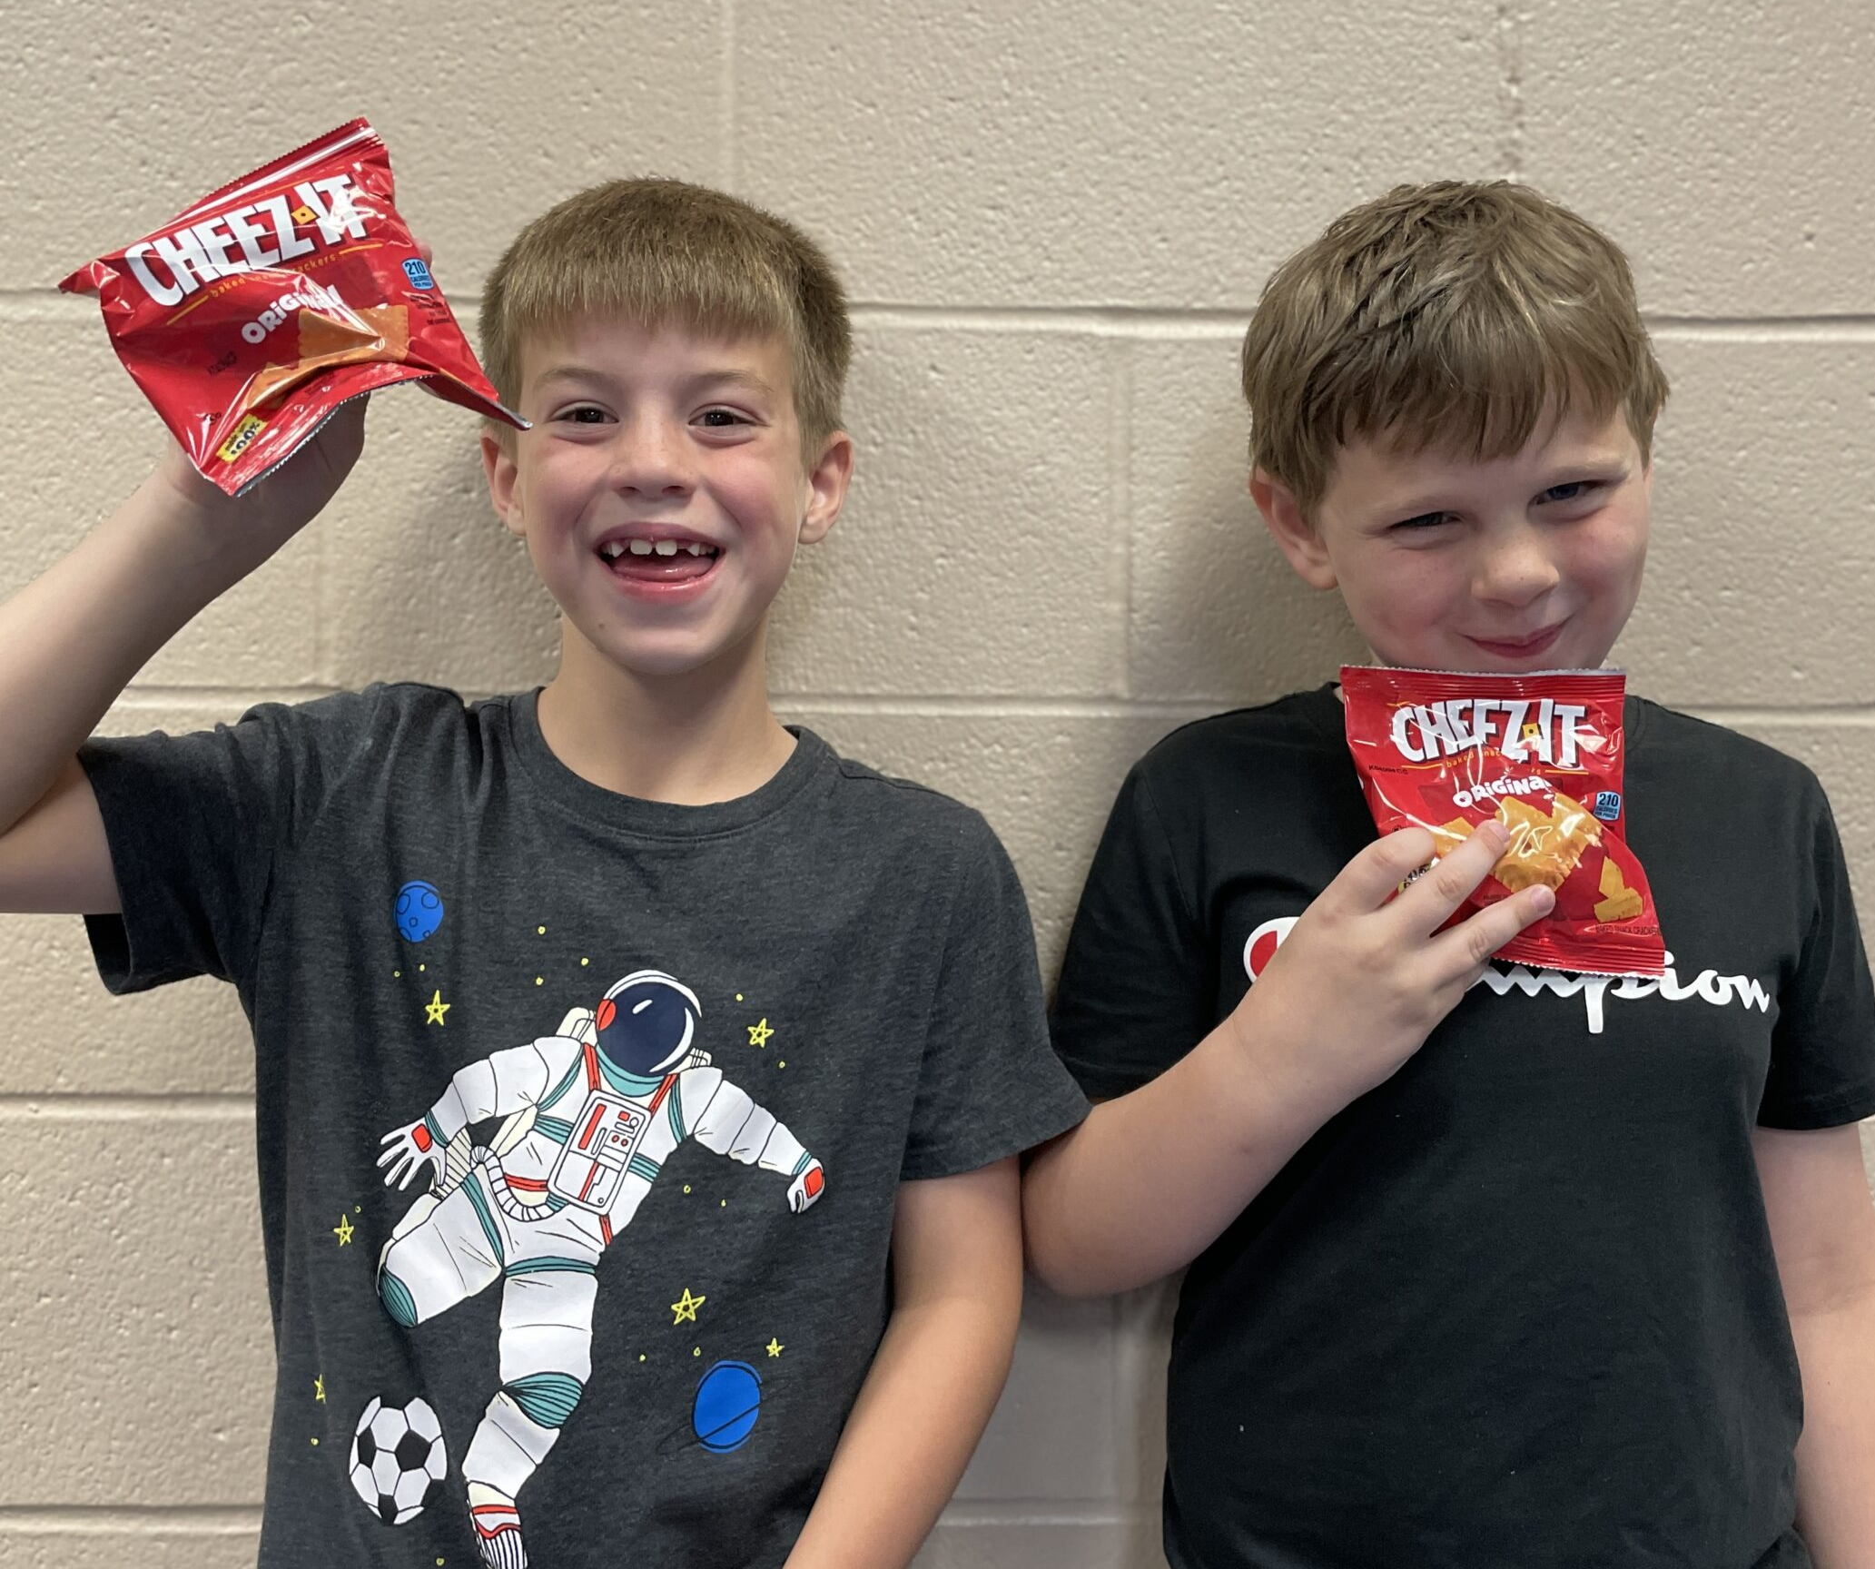
BackSnack Impact
Harvesters provides nearly
5,000 BackSnacks
to students every weekend during the school year.

Slide 12
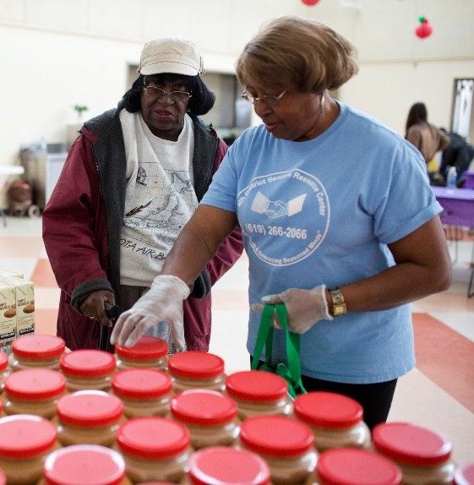
Feeding Seniors
15 percent of who we serve are over 55 years old.
Seniors receive assistance through Senior Mobile Food pantries.
Many agencies also distribute monthly commodity food boxes to low-income seniors.

Slide 13
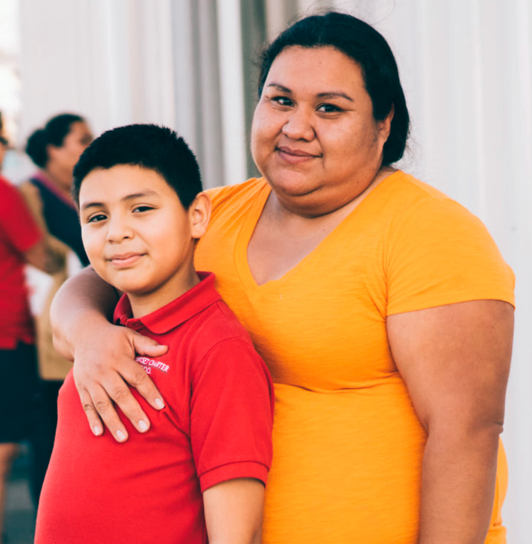
Feeding Families
Harvesters’ network feeds many working families.
Under-employment and low household income are key factors in the high need for food assistance.
Many households relying on Harvesters’ agencies may face health challenges.

Slide 14
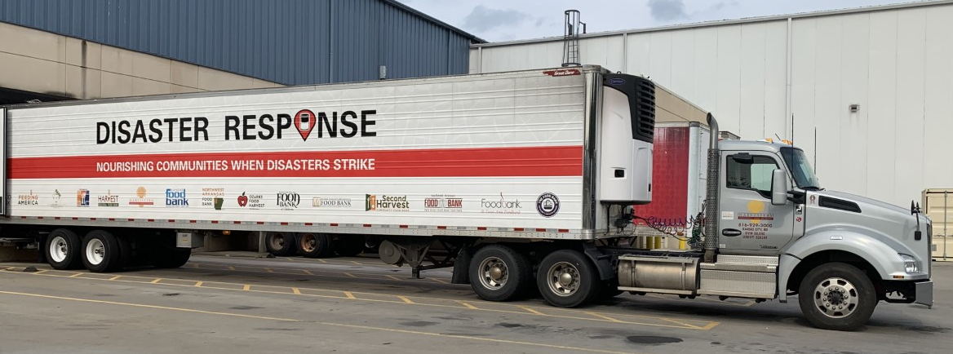
Disaster Relief
Harvesters is one of
Feeding
America’s
disaster relief sites.
Our team provides
assistance to communities
affected by natural disasters.
www.harvesters.org

Slide 15

Our Impact
In fiscal year 2025,
Harvesters' network
distributed more than
52 million meals.

Slide 16
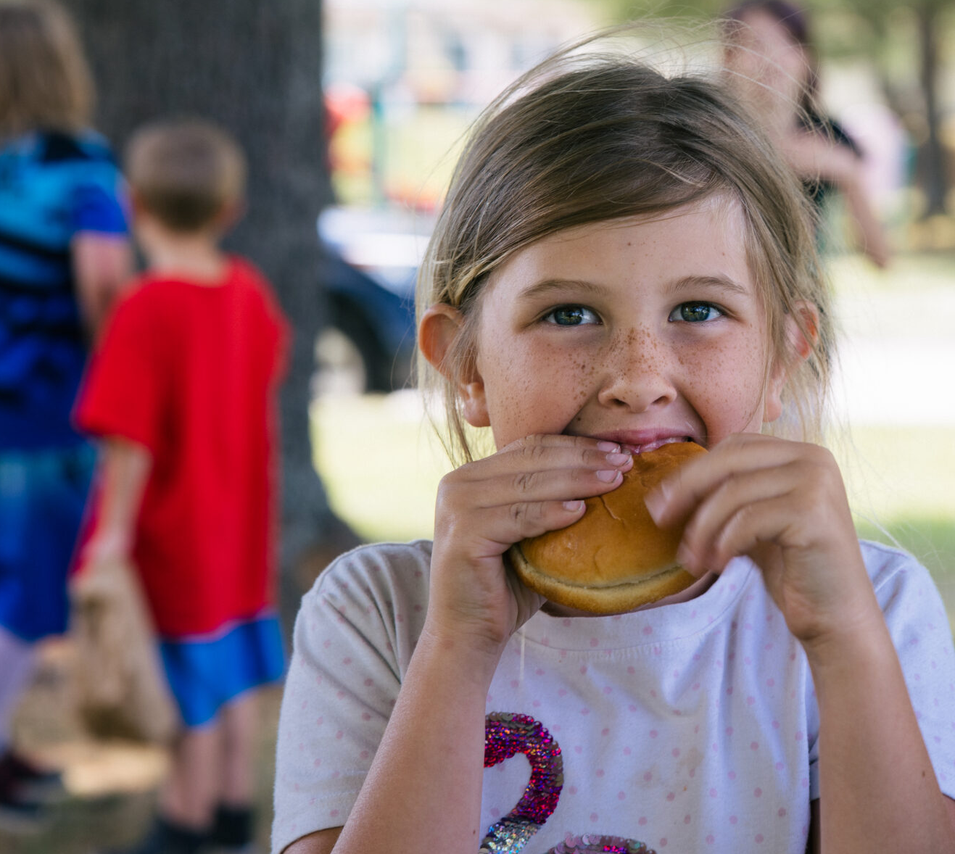
Our Impact
69 school pantries reached nearly 28,000 families.

Slide 17





Our Impact
50 Food+ partnerships helped address the root causes of hunger.

Slide 18
We Strive for Excellence
Harvesters has earned
its 14th consecutive
4 Star Rating
From Charity Navigator. This is the highest possible rating and shows Harvesters executes its mission in a financially efficient way.
www.harvesters.org

Slide 19
How You Can Help
Give Food
Give Time
Give Money
Give Voice

Slide 20
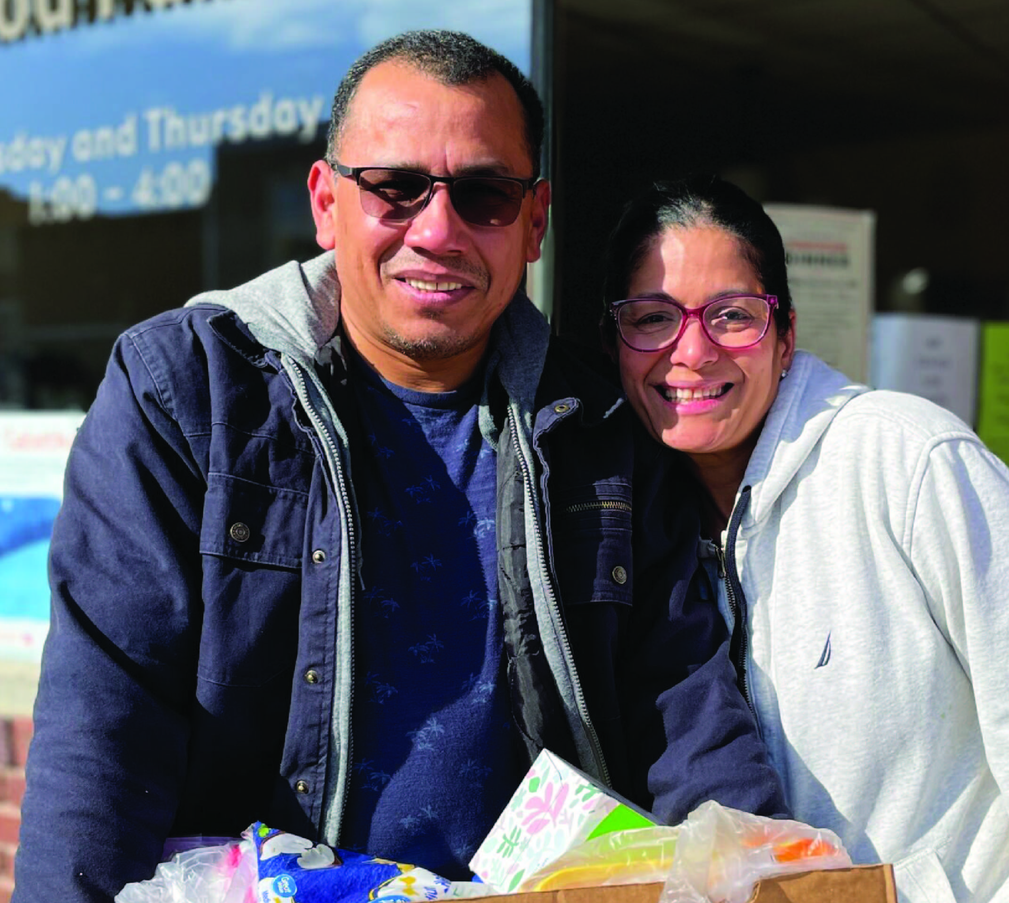
Give Money
Did you know, a donation
of just $1 helps Harvesters provide 2 meals?
$1 = 2 meals

Slide 21
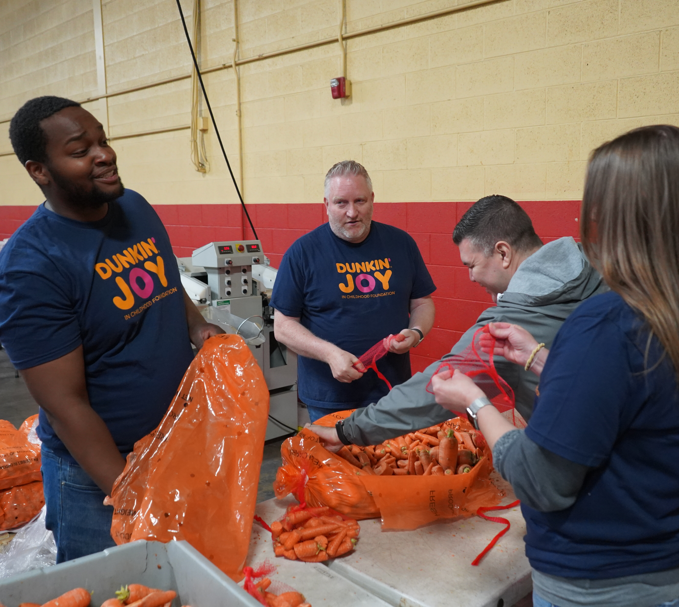
Give Time
Visit harvesters.org to sign up yourself or a group to volunteer at one of our locations or at an event!

Slide 22
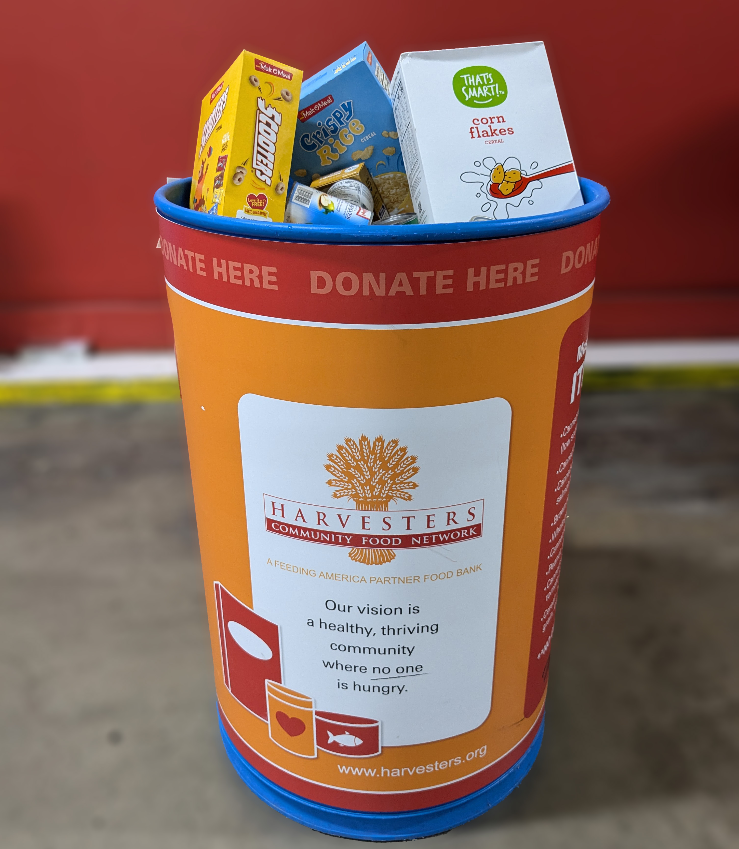
Give Food
Donate nonperishable goods in one of our collection barrels, at a food drive, or at one of our locations. You can also visit our website to learn how to host your own food drive!

Slide 23
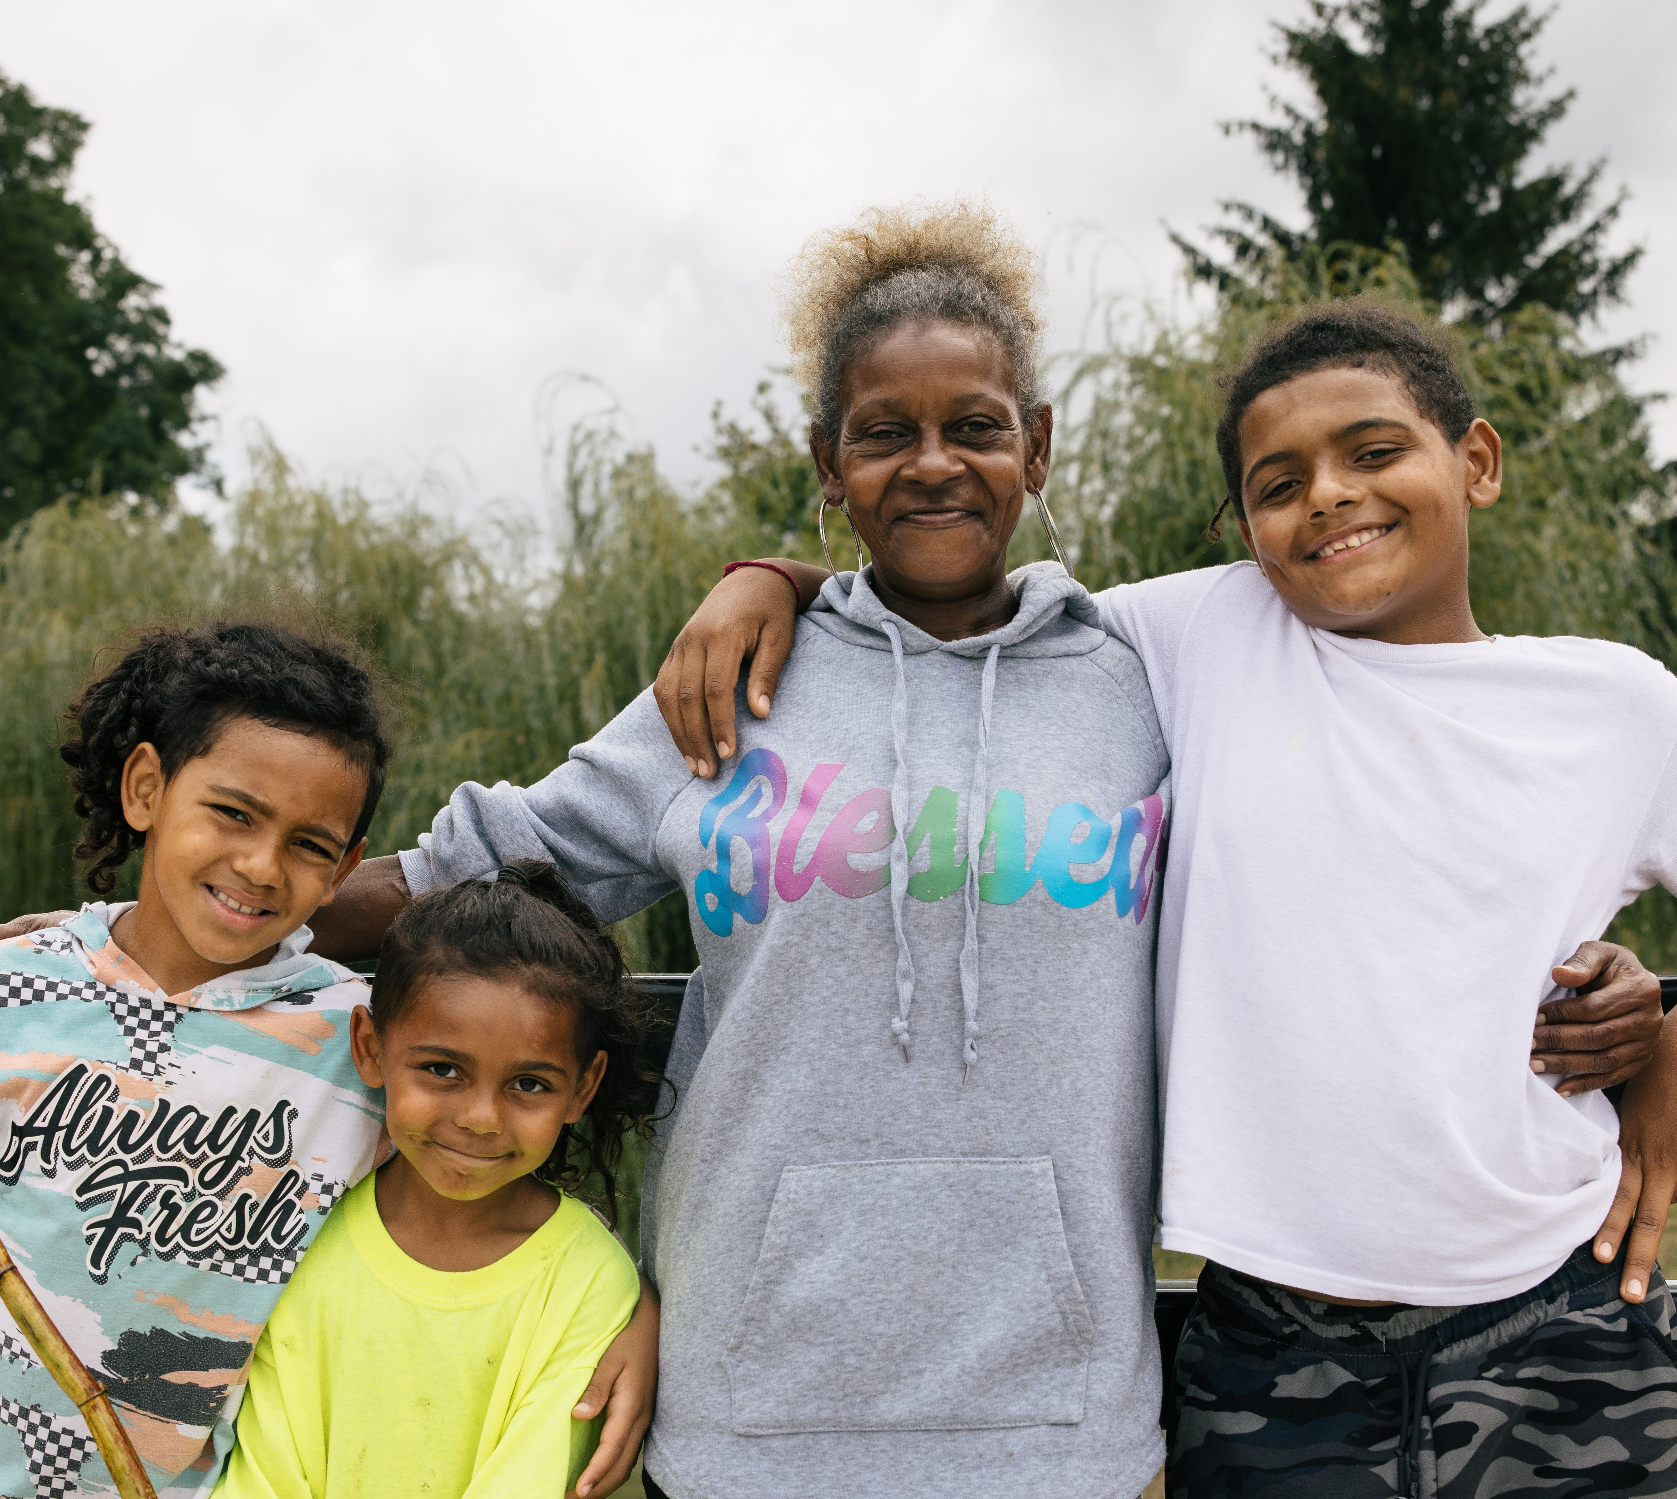
Give Voice
Sign up for Harvesters’ Advocacy Beet to find out how to support hunger relief for your neighbors.

Slide 24




Stay Connected
www.harvesters.org

